Slide 1
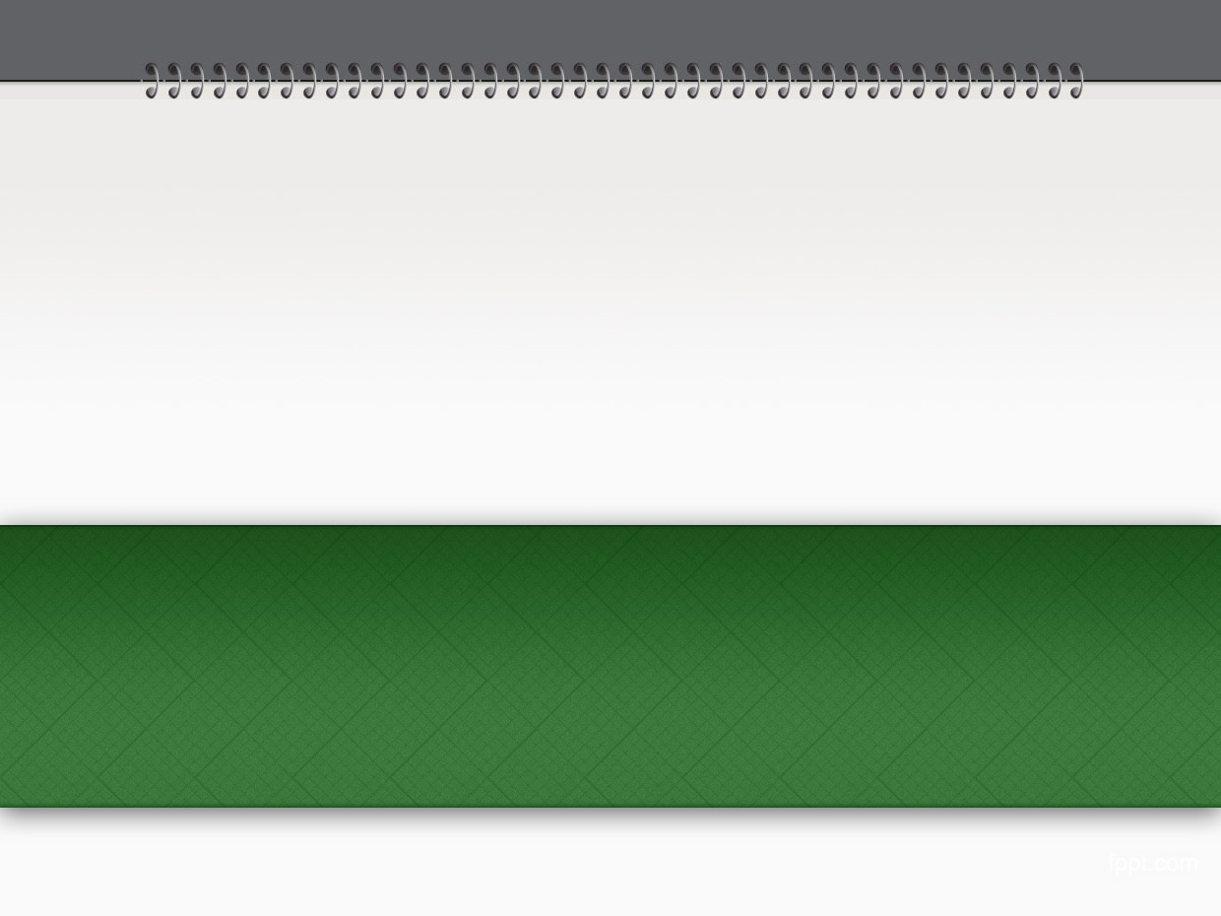


http://pingo.edu.vn/khoa-hoc-php-can-ban/
PHP Basics - Arrays
Web Applications in Hatch
Tuan Duong
http://pingo.edu.vn/tuan-duong/

Slide 2
Groups of variables
So far, we have stored ONE piece of data in each variable.
It is also possible to store multiple pieces of data in ONE variable by using an array.
Each piece of data in an array has a key…

Slide 3
Contents
PHP Arrays: Introduction
3 types of arrays in PHP
Accessing elements in arrays
Split a String
Sorting
Array and Loops
Array Manipulations
Some array funtions in PHP

Slide 4
Introduction
8 data types:
Scalar
String : “the php class…”, “123456”, ‘a’
Integer : 123, -10, 98244
Float : 18.81, -192.34, 3.1412926323
Boolean : true, false
Compound
Array : [1, 2, 3], [“John”, “Tom”, “Jerry”]
Object : OOP
Special
Resource : Handle (file, mysql connection)
Null : Something that not nothing (empty value)

Slide 5
Introduction
Programming languages use variables to store values
An array is a data structure that stores one or more values in a single value.
Arrays can be single-dimensional or multidimensional
An array in PHP is actually an ordered list.
An array index (key) is used to access an element
An array element can be of any type

Slide 6
PHP Arrays
Arrays are aggregate values – combination of values, each assigned a key in the array
PHP supports associative arrays – keys may be numeric, strings or any other scalar data types
Keys must be unique across the array
Values in the array may be with different types
PHP Arrays are dynamic – they don’t require explicit size when created

Slide 7
PHP Arrays
PHP Array is declared with keyword array
"=>" means "points to"
If keys are not supplied they are assigned automatically, starting from 0
<?
// simple array
$arr = array ("a", "b", 7);
// this produces $arr[0], $arr[1] and $arr[2]
// whit values respectively "a", "b" and 7
$arr2 = array ("one" => 1, "two" => 2);
// this produces $arr2["one"] and $arr2["two"]
// whit values respectively 1 and 2
?>

Slide 8
PHP Arrays
We access value in the array with "[" and "]" containing the key
Arrays are flexible and types of values and keys may be mixed
<?
$arr = array ("a", "b", 7, "one" => 1, "two" => 2, "other" => array(1,2,3));
// keys types may be mixed:
// $arr[0] will be "a" and $arr["one"] will be 1
// $arr["other"] is also array
// $arr["other"][0]" is 1
print $arr["other"][2]; // will output 3
?>

Slide 9
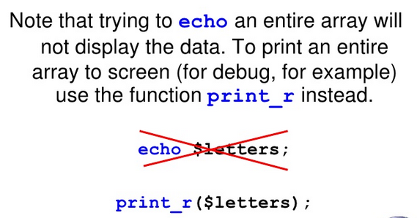
PHP Arrays

Slide 10
3 types of arrays
Indexed array
Associative array
Multidimensional array

Slide 11
Indexed array
<?php
$numberArray = array(1, 2, 3, 4, 5, 6);
$emailArray = array(“Bryan”, “Chris”, “Michael”);
print_r($numberArray);
var_dump($emailArray);
?>

Slide 12
Associative array
<?php
$fruitArray = array(
"red" => "apple",
"yellow" => "banana",
"purple" => "plum",
"green" => "grape"
);
print_r($fruitArray);
?>

Slide 13
Multidimensional array
Array of arrays
<?php
$nameArray = array(
array("Scooby", "Shaggy", "Daphne", "Fred", "Velma"),
array("Bugs", "Daffy", "Tweety", "Elmer", "Foghom")
);
print_r($nameArray);
?>

Slide 14
Define an Array
- The simplest way to define an array variable is the array() function
<?php
$nameArray = array(
array("Scooby", "Shaggy", "Daphne", "Fred", "Velma"),
array("Bugs", "Daffy", "Tweety", "Elmer", "Foghom")
);
print_r($nameArray);
?>

Slide 15
Define an Array
- Can define an array by specifying values for each element in the index notation
<?php
$nameArray = array();
$nameArray[0] = "Scoopy";
$nameArray[1] = "Shaggy";
$nameArray[2] = "Daphne";
var_dump($nameArray);
?>

Slide 16
Define an Array
- Also can define an array by using keys rather than default numeric index.
<?php
$menuArray = array();
$menuArray['breakfast'] = "bacon and eggs";
$menuArray['lunch'] = "roast beef";
$menuArray['dinner'] = "lassgna";
var_dump($menuArray);
?>

Slide 17
Modify an Array
- Modify the element by using its key/index and assign new value.
<?php
// Indexed array
$colorArray = array("yellow", "white", "red", "silver");
print_r($colorArray);
$colorArray[2] = "purple";
print_r($colorArray);
// Associative array
$menuArray = array(
"breakfast" => "bacon and eggs",
"lunch" => "roast beef",
"dinner" => "lassgna"
);
var_dump($menuArray);
$menuArray["lunch"] = "nothing";
var_dump($menuArray);
?>

Slide 18
Push and Pull
Adding an element to the end of existing array with the array_push() function;
Example;
<?php
// define an array
$pasta = array('spaghetti', 'penne', 'macaroni');
// add an element to the end
array_push($pasta, 'tagliatelle');
print_r($pasta);
?>
//Output
Array ( [0] => spaghetti [1] => penne [2] => macaroni
[3] => tagliatelle )

Slide 19
Push and Pull
Adding an element to the beginning of existing array with the array_unshift() function;
Example;
<?php
// define an array
$pasta = array('spaghetti', 'penne', 'macaroni');
// add an element to the end
array_unshift($pasta, 'pizza');
print_r($pasta);
?>
//Output
Array ( [0] => pizza [1] => spaghetti [2] => penne
[3] => macaroni

Slide 20
Push and Pull
Removing an element from the end of an array using the interestingly-named array_pop() function.
Example;
<?php
// define an array
$pasta = array('spaghetti', 'penne', 'macaroni');
// remove an element from the end
array_pop($pasta);
print_r($pasta);
?>
//Output
Array ( [0] => spaghetti [1] => penne )

Slide 21
Push and Pull
Removing an element from the top of an array using the interestingly-named array_shift() function.
Example;
<?php
// define an array
$pasta = array('spaghetti', 'penne', 'macaroni');
// remove an element from the top
array_shift($pasta);
print_r($pasta);
?> //Output
Array ( [0] => penne[1] => macaroni )

Slide 22
Split a String
The explode() function splits a string into smaller components, based on a user-specified delimiter, and returns the pieces as elements as an array.
Example;
<?php
$str = 'red, blue, green, yellow';
// split into individual words
$colors = explode(', ', $str);
print_r($colors);
?>
//Output Array ( [0] => red [1] => blue [2] => green [3] => yellow )

Slide 23
Split a String
The implode() function can creates a single string from all the elements of an array by joining them together with a user-defined delimiter.
Example;
<?php // define array
$colors = array ('red', 'blue', 'green', 'yellow');
// join into single string with 'and'
// returns 'red and blue and green and yellow'
$str = implode(' and ', $colors);
print $str;
?> //Output
red and blue and green and yellow

Slide 24
Sorting
sort()
The sort() function arranges the element values into an alphabetical order(Ascending)
Example:
<?php
// define an array
$pasta = array('spaghetti', 'penne', 'macaroni');
// returns the array sorted alphabetically
sort($pasta);
print_r($pasta);
?>
//Output
Array ( [0] => macaroni [1] => penne [2] => spaghetti )

Slide 25
Sorting
rsort()
The rsort() function sort the element values into the descending alphabetical order
Example;
<?php
// define an array
$pasta = array('spaghetti', 'penne', 'macaroni');
// returns the array sorted alphabetically
rsort($pasta);
print_r($pasta);
?>
//Output
Array ( [0] => spaghetti [1] => penne [2] => macaroni )

Slide 26
Size of an array
The count() and sizeof() functions are identical in use and effect. They return the number of elements in the array.
Example;
<?php
// define an array
$animals = array('dog', 'cat', 'fish');
echo count($animals) . "<br />";
echo sizeof($animals);
?>
//Output
3
3

Slide 27
Looping the Loop
We can read an entire array by simply loop over it, using any of the loop constructs.
Example;
<?php
// define array
$artists = array('Metallica', 'Evanescence', 'Linkin Park', 'Guns n Roses');
// loop over it and print array elements
for ($x = 0; $x < sizeof($artists); $x++) {
echo '<li>'.$artists[$x];
}
?>
//Output
Metallica
Evanescence
Linkin Park
Guns n Roses

Slide 28
Looping the Loop
The sizeof()/count() function is one of the most important and commonly used array functions.
It returns the size of (read: number of elements within) the array.
It is mostly used in loop counters to ensure that the loop iterates as many times as there are elements in the array.
By using an associative array, the array_keys() and array_values()functions come in handy, to get a list of all the keys and values within the array.

Slide 29
Looping the Loop
There is a simpler way of extracting all the elements of an array by using foreach() loop.
A foreach() loop runs once for each element of the array passed to it as argument, moving forward through the array on each iteration.
Unlike a for() loop, it doesn't need a counter or a call to sizeof(), because it keeps track of its position in the array automatically.
On each run, the statements within the curly braces are executed, and the currently-selected array element is made available through a temporary loop variable.
Example;
<?php
// define array
$artists = array('Metallica', 'Evanescence', 'Linkin Park', 'Guns n Roses');
// loop over it and print array elements
foreach ($artists as $artist) {
echo '<li>'.$artist;
}
?>

Slide 30
Looping the Loop
// Output
Metallica
Evanescence
Linkin Park
Guns n Roses
Each time the loop executes, it places the currently-selected array element in the temporary variable $artist.
This variable can then be used by the statements inside the loop block
foreach() loop doesn't need a counter to keep track of where it is in the array
Much easier to read than a standard for() loop.

Slide 31
Array And Loops
Arrays and loops also come in handy when processing forms in PHP
For example, if want to have a group of related checkboxes or a multi-select list, just use an array to capture all the selected form values in a single variable, to simplify processing
Example;

Slide 32
Array And Loops
<html>
<?php
if (!isset($_POST['submit'])) {
?>
<form action="<?php echo $_SERVER['PHP_SELF']; ?>" method="POST">
<input type="checkbox" name="artist[]" value="Bon Jovi">Bon Jovi
<input type="checkbox" name="artist[]" value="N'Sync">N'Sync
<input type="checkbox" name="artist[]" value="Boyzone">Boyzone
<input type="submit" name="submit" value="Select">
</form>
<?php
} else {
// or display the selected artists
// use a foreach loop to read and display array elements
if (is_array($_POST['artist'])) {
echo 'You selected: <br />';
foreach ($_POST['artist'] as $artist) {
echo "<i>$artist</i><br />";
}
} else {
echo 'Nothing selected';
}
}
?>
</html>

Slide 33
Multidimensional Array
<?php
$products = array(
array('TIR', 'Tires', 100),
array('OIL', 'Oil', 10),
array('SPK', 'Spark Plugs', 4)
);
for ($row = 0; $row < 3; $row++) {
for ($column = 0; $column < 3; $column++) {
echo '| ' . $products[$row][$column];
}
echo ' |<br/>';
}
?>

Slide 34
each() and list()
each() function
Returns the current key and value pair from the array and advances the array
cursor. This pair is returned in a two-element array, with the key and value of the array element.
<?php
$fruit = array(
'a' => 'apple',
'b' => 'banana',
'c' => 'cranberry'
);
while (list($key, $val) = each($fruit)) {
echo "$key => $val <br />";
}
?>
The above example will output:
a => apple b => banana c => cranberry

Slide 35
reset() function
rewinds array's internal pointer to the first element and returns the value of the
first array element, or FALSE if the array is empty.
<?php
$array = array('step one', 'step two', 'step three', 'step four');
// by default, the pointer is on the first element
echo current($array) . "<br />"; // "step one"
// skip two steps
next($array);
next($array);
echo current($array) . "<br />"; // "step three“
prev($array);
echo current($array) . "<br />"; // "step two"
// reset pointer, start again on step one
reset($array);
echo current($array) . "<br />"; // "step one"
?>

Slide 36
Some array functions
array_keys: Returns all the keys or subset of the keys of an arrays
array_values: Returns all the values of an array
array_merge: Merges one or more arrays
array_replace: Replaces elements from passed arrays into the first array
array_search: Searches the array for a given value and returns the corresponding key if successful.
array_slice: Extracts a slice of the array
array_sum: Calculates the sum of values in an array
array_unique: Removes duplicate values from an array
in_array: Cheks if a value exists in an array

Slide 37
Summary
Really only one type of array: Associative
Data content is non-restrictive, any data type
Each element can be different
Array sizes change dynamically
Supports no known limit of dimensions
How much memory in your machine?
Humans like 2 or 3 (think spreadsheet and workbook)
Both index and content can change
Got Doc? http://www.php.net/array

Slide 38
PHP Arrays

